Slide 1
Target Marketing
Mohamed Noordeen A
June 17, 2017

Slide 2
Industry, Technique and State of Art
Plumbing Company – Market Analysis – Target Customer
Churn Prediction
Clustering the customer based on age, gender, demographics, profession, income level and target them appropriately
References : http://plumbingmarketing.net/kimberly-kean-gene-johnson-plumbing

Slide 3


State of Art – Target marketing
Owner - Male – 50y – 90k
Agent – Female – 40y – 70k
Reference : https://www.linkedin.com/pulse/6-types-customers-plumbing-industry-you-need-know-david-w-

Slide 4
Practical Project and Goal of Project
Practical Project:
Dan Dowdy of S&D Plumbing
Gene Johnson Plumbing
Daniel Cordova & Laurie Castillo of Daniel Cordova Plumbing
Our Project Goal’s:
Based on the past 3 years customer data predict the customer will churn or not
If the customer is back for which service he will opt for.
References : http://plumbingmarketing.net/kimberly-kean-gene-johnson-plumbing

Slide 5
How will it help if I solve the problem
Marketing expenses can be decreased
Finding potential customer and give promotion package
Finding likely to be churned customers and can provide discounts to stay engaged
Finding the potential state, city and locality to prioritize the dispatch
Forecasting the churn and revenue numbers for allocating the resources

Slide 6
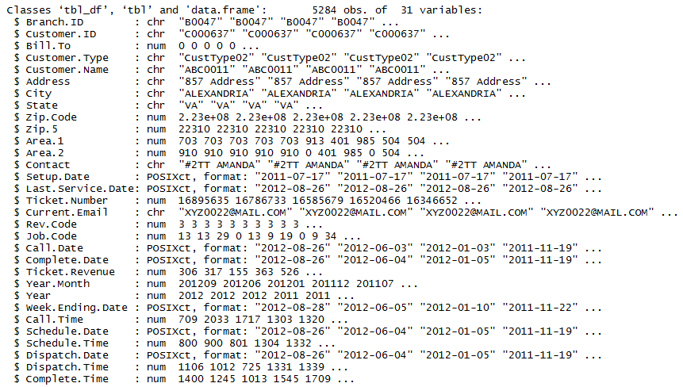
Data Given

Slide 7
Benchmark
Error Metrics – Confusion Matrix
Accuracy with 80%
Train and test accuracy should be nearby

Slide 8
Data set
Loads of Feature Engineering
36 Features
5 Factor variable
5 Date variable
4 Time variable
8 Character variable
9 Numeric variable

Slide 9
Strategy to solve problem
Past Delay
Past Pricing
Last complete duration
Geological influence
Loyalty of customer

Slide 10
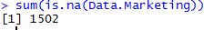
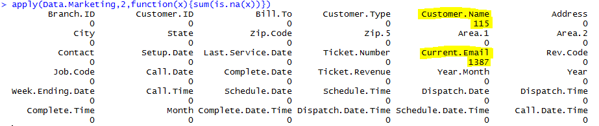
Data Discovery
Dimensions
Unique Data
NA
NA column level

Slide 11
Feature Engineering
Appended all date and time
Sorting the data based on customer ID's and their call date
Adding the visit number for each customer
Finding Customer Callback days
Finding Customer Ticket Transaction
Differencing setup date and call date
Differencing call date and schedule date
Differencing Schedule and Dispatch date

Slide 12
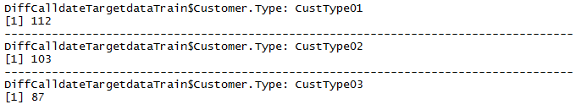
Feature Engineering
Differencing Dispatch and Complete date
Differencing call and Complete date
Made the data column zero if it is negative
Finding the threshold
Setting the churn data column based on threshold

Slide 13
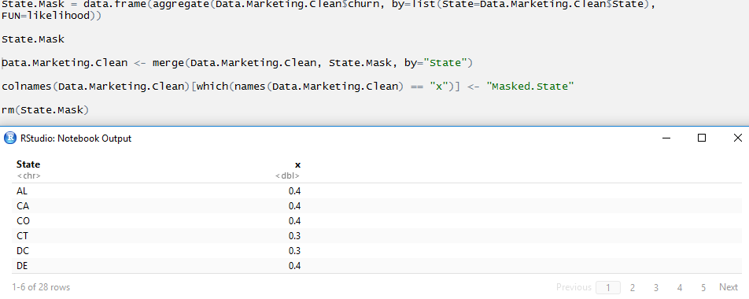
Feature Engineering
Masked the State based on probability of churn

Slide 14
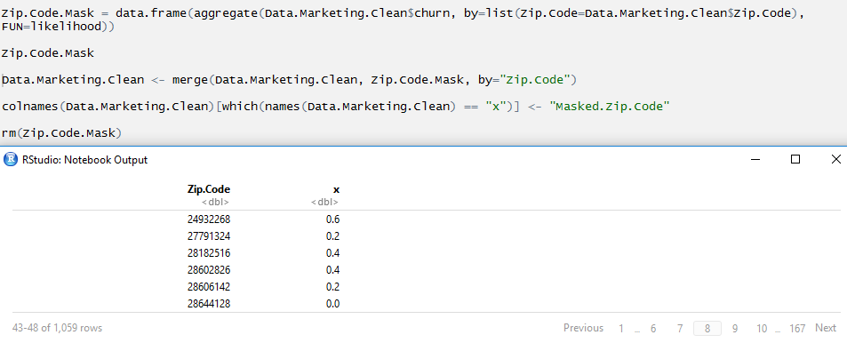
Feature Engineering
Masked the Zip Code based on probability of churn

Slide 15
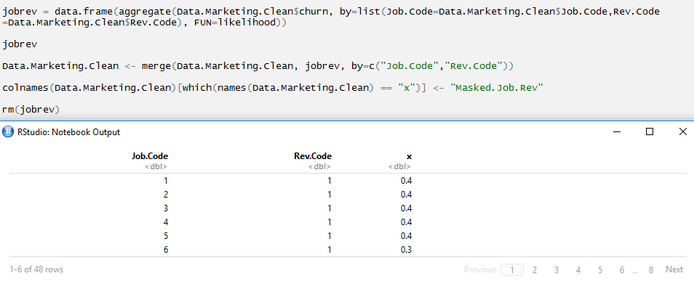
Feature Engineering
Masked the Job Code and Revenue Code based on probability of churn

Slide 16
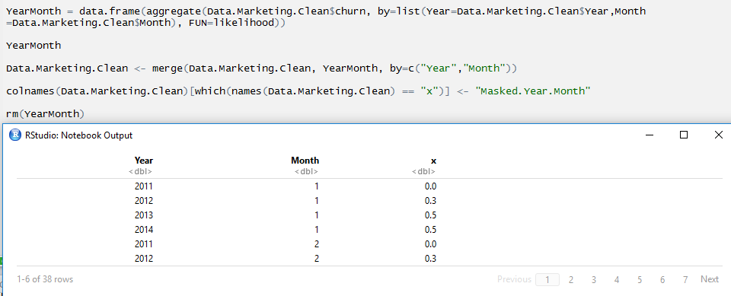
Feature Engineering
Masked the Year and Month based on probability of churn

Slide 17
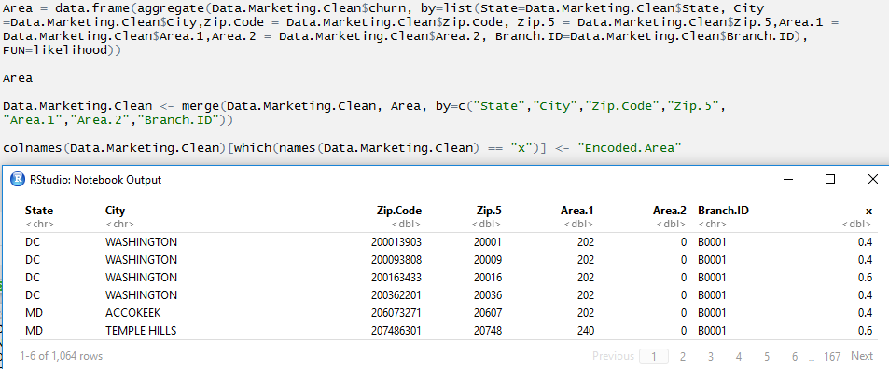
Feature Engineering
Masked the all geographic related data to area based on probability of churn

Slide 18
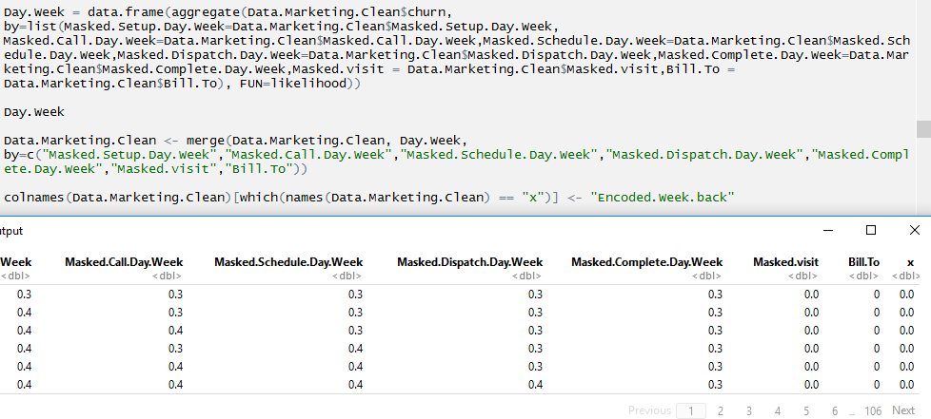
Feature Engineering
Found the week day of all the dates and found the probability churn for particular week

Slide 19
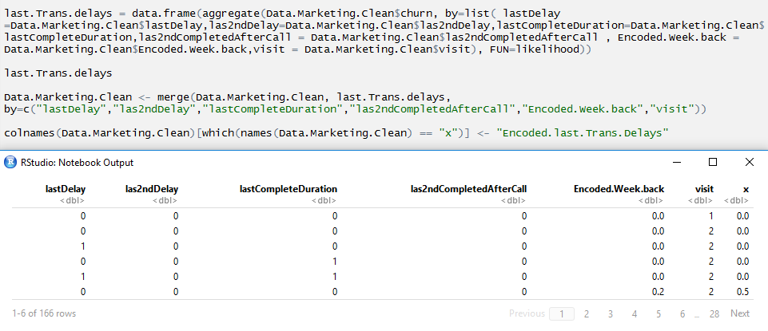
Feature Engineering
Found the last 2 delay of the service.
Found the last 2 complete duration

Slide 20
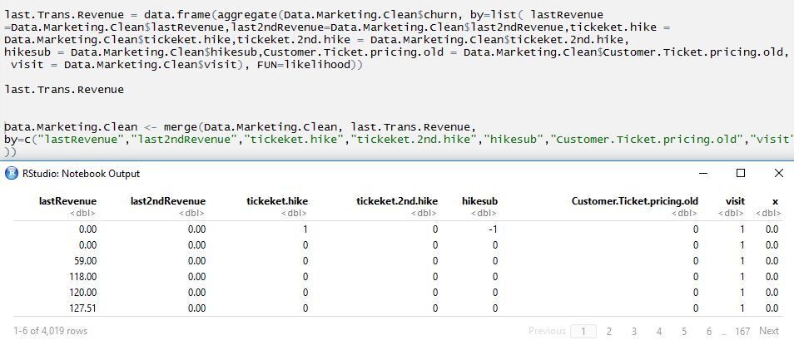
Feature Engineering
Last 2 ticket pricing

Slide 21
Feature Engineering – Remove first transaction
Remove the first transaction of each customer
Because it is always un-churned data
Model is unwantedly learning the data
After removing the data the train and test accuracy is very close

Slide 22
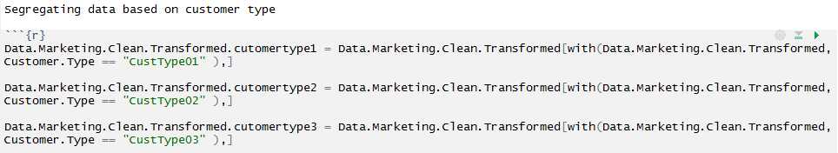
Feature Engineering – Segregating Data
Dividing the data based on customer type

Slide 23
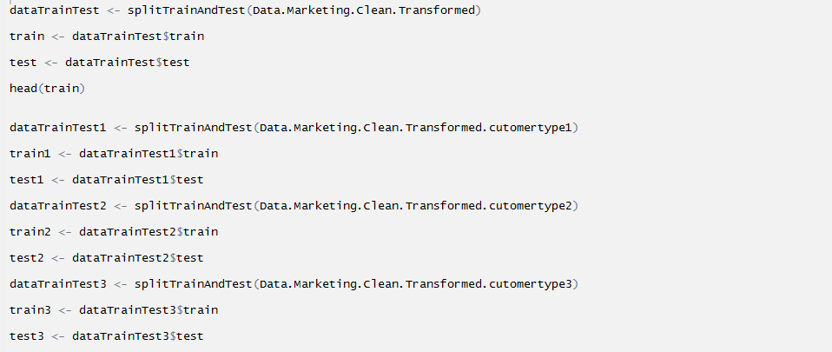
Feature Engineering – Splitting data
Split the data train and test

Slide 24
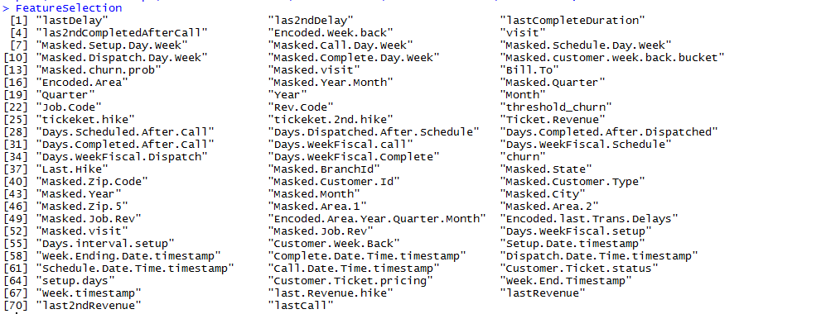
All Derived Features

Slide 25
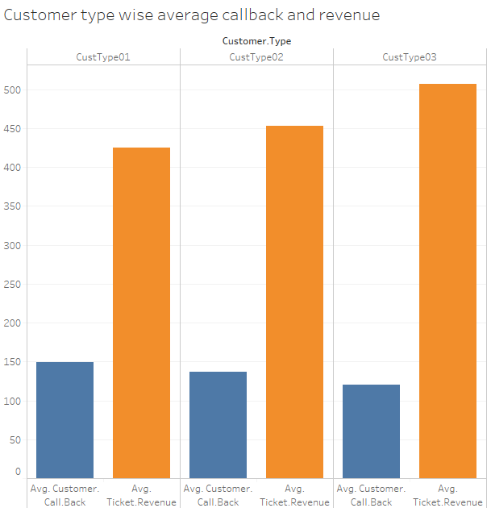
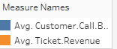
Customer Type – Callback and Ticket revenue

Slide 26
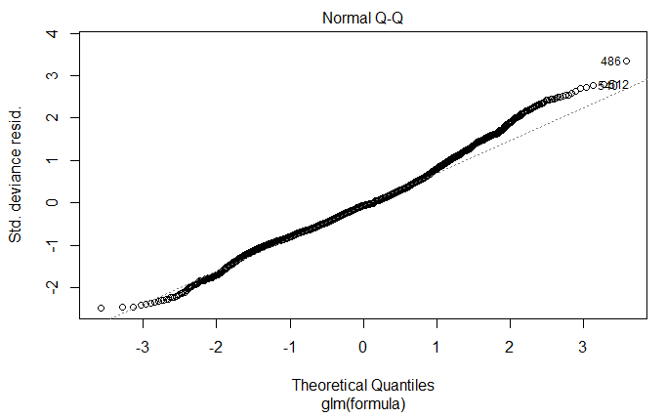
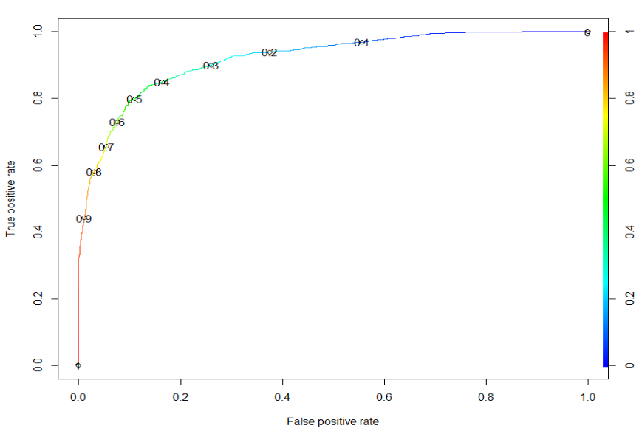
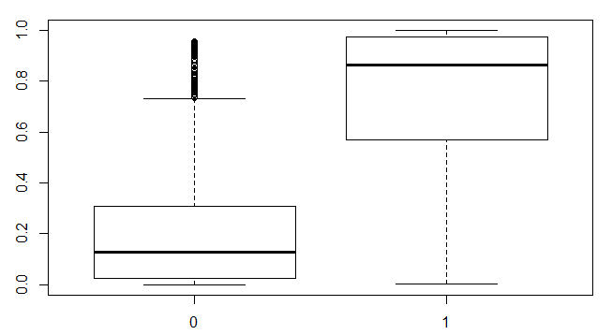
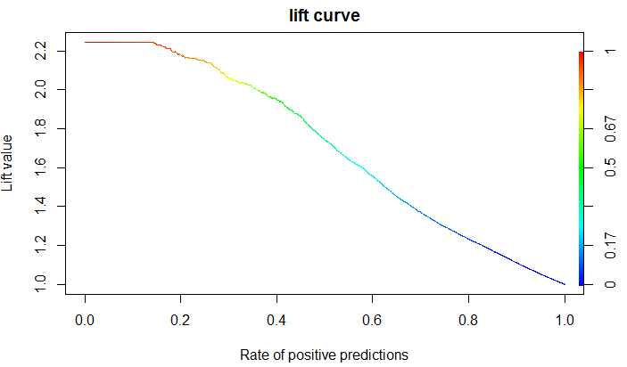
Model Building – Logistic Regression

Slide 27
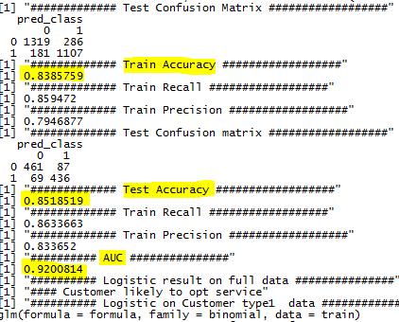
Model Building – Logistic Regression

Slide 28
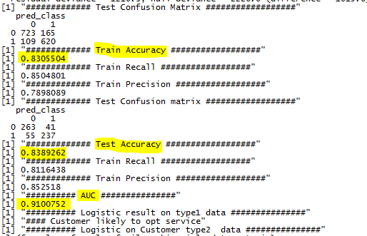
Model Building – Logistic Regression

Slide 29
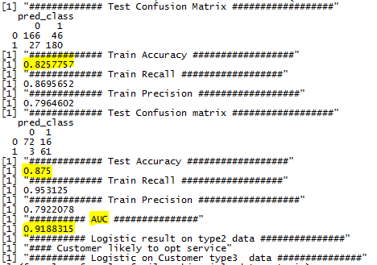
Model Building – Logistic Regression

Slide 30
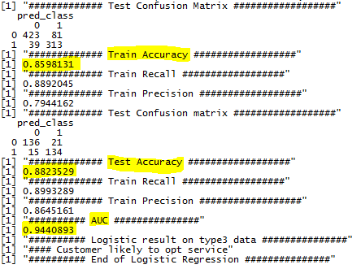
Model Building – Logistic Regression

Slide 31
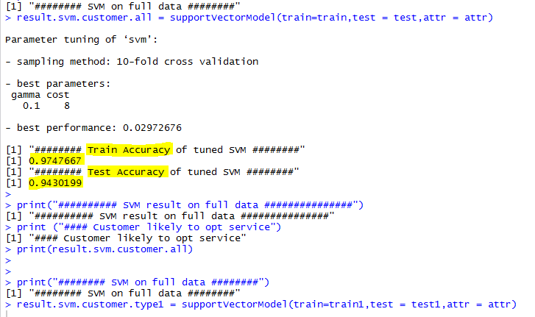
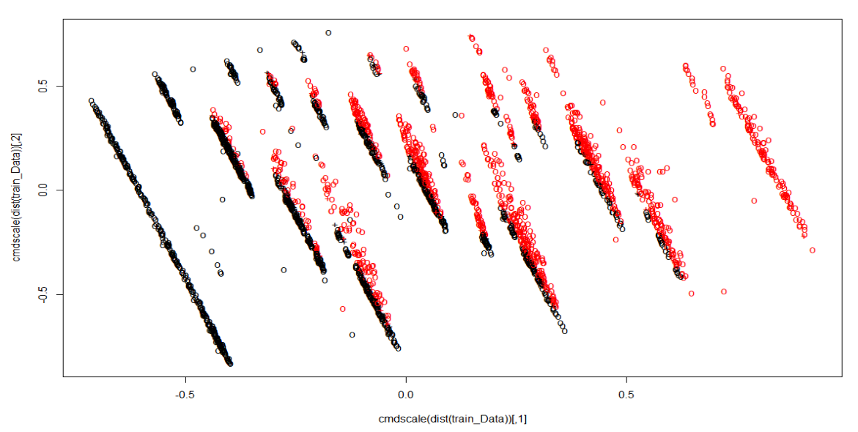
Model Building – SVM

Slide 32
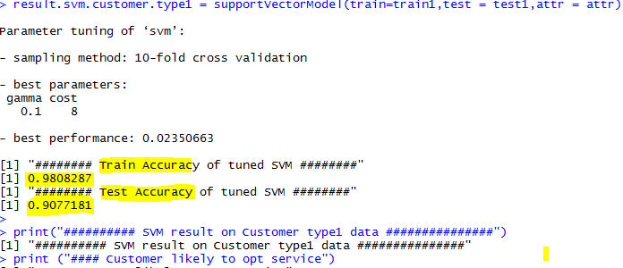
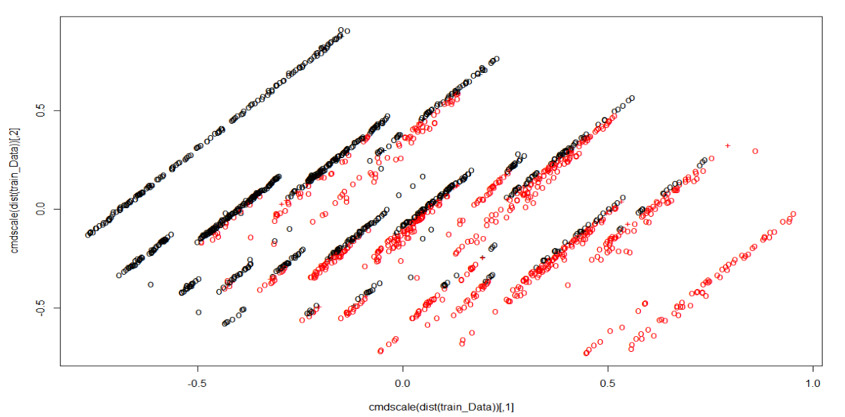
Model Building – SVM

Slide 33
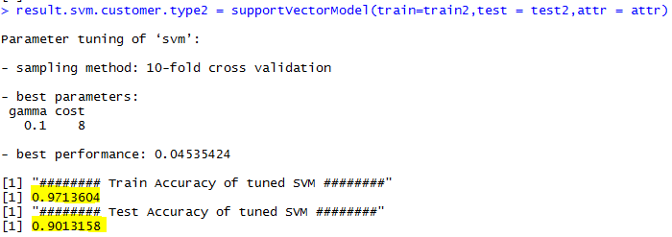
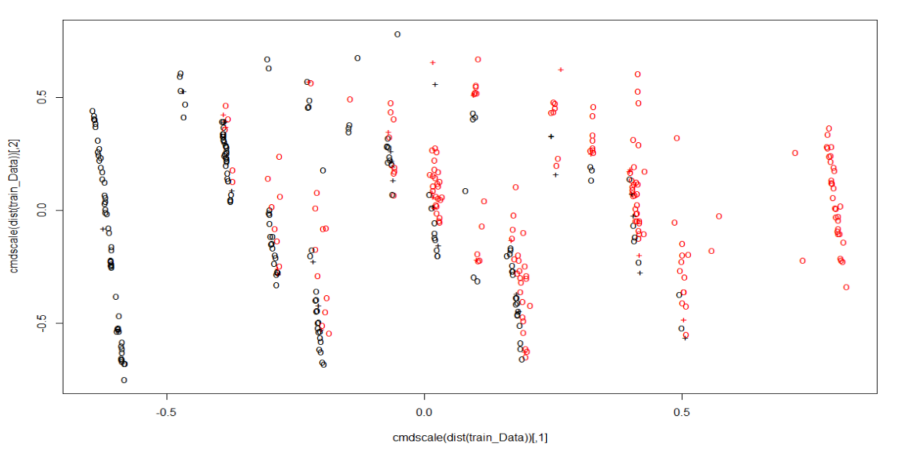
Model Building – SVM

Slide 34
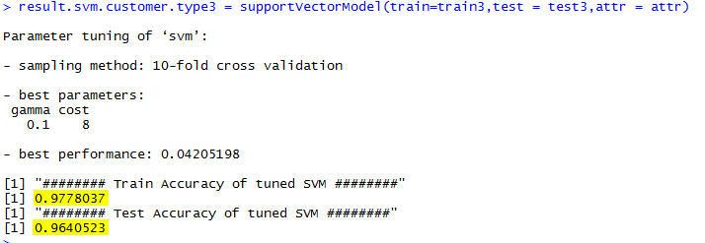
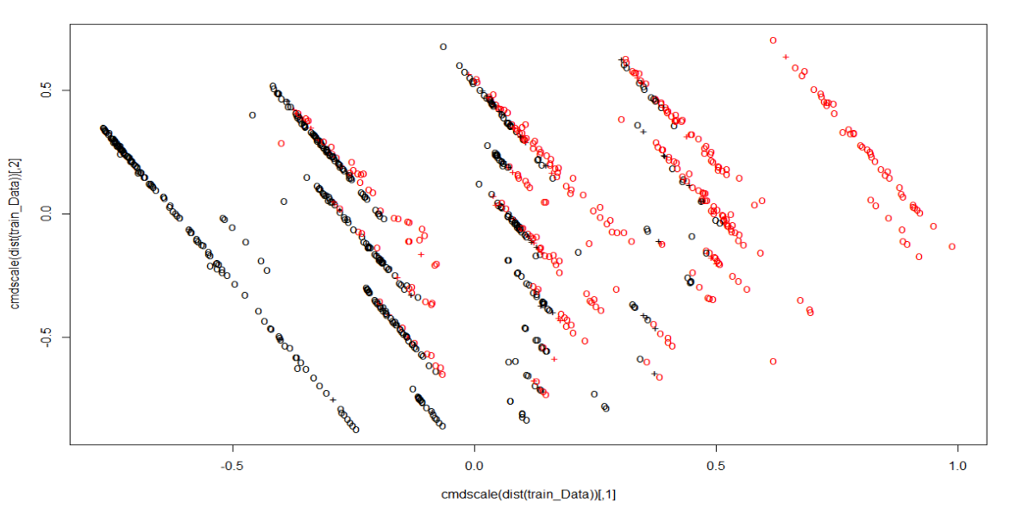
Model Building – SVM

Slide 35
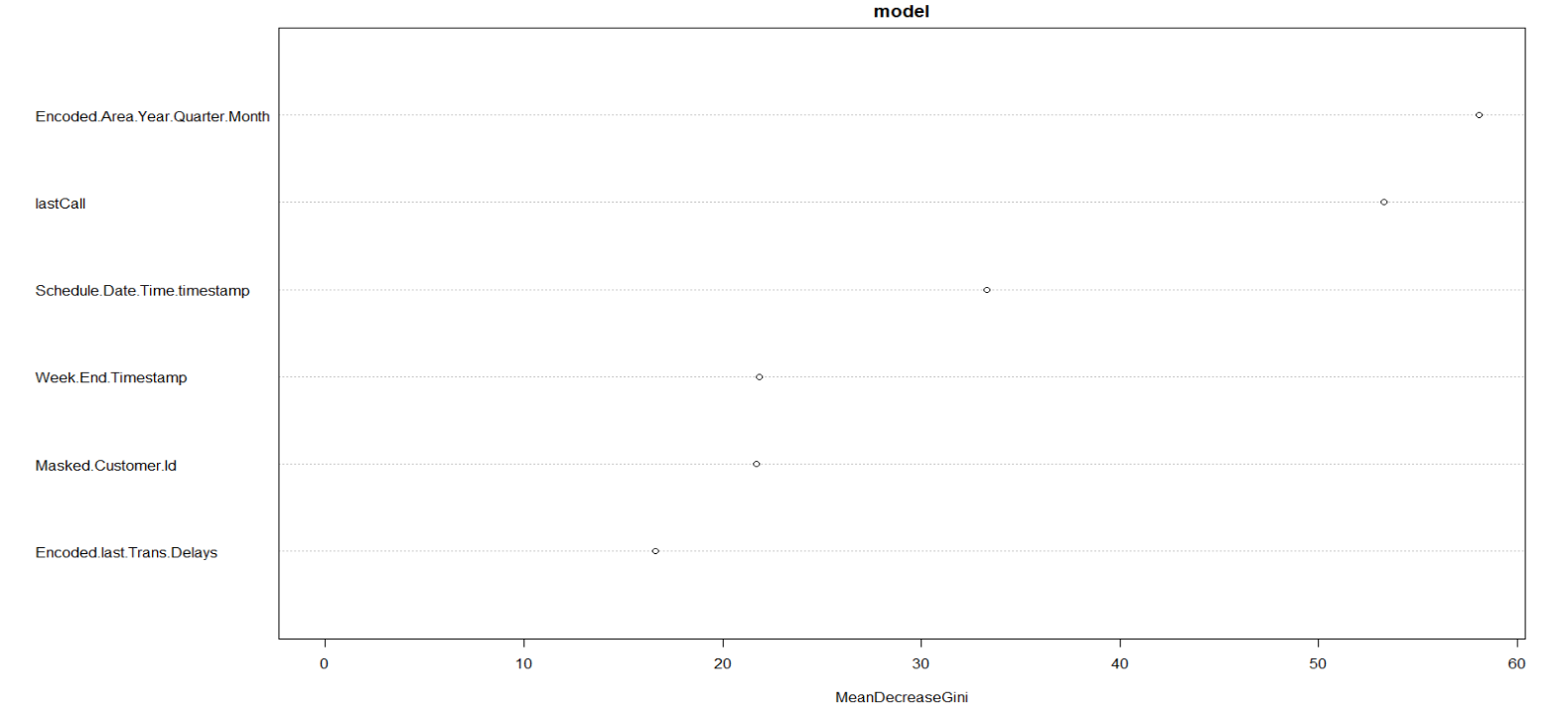
Model Building – Random Forest

Slide 36
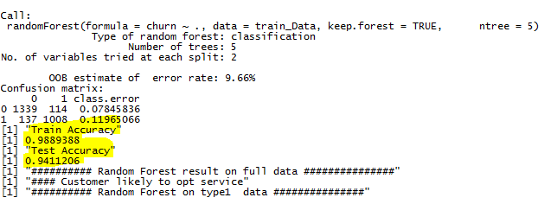
Model Building – Random Forest

Slide 37
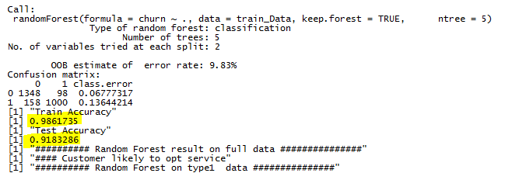
Model Building – Random Forest

Slide 38
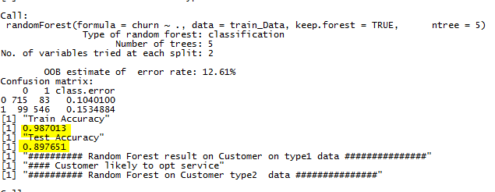
Model Building – Random Forest

Slide 39
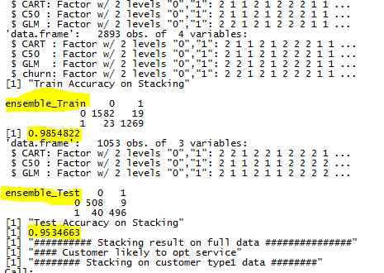
Model Building – Stacking Ensemble

Slide 40
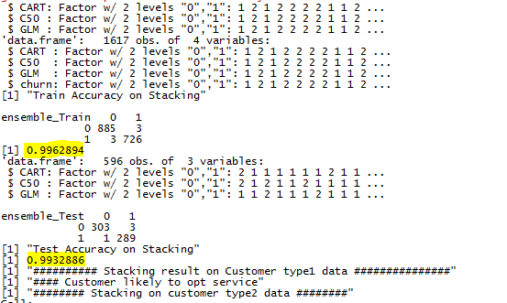
Model Building – Stacking Ensemble

Slide 41
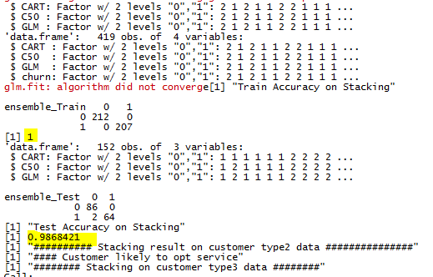
Model Building – Stacking Ensemble

Slide 42
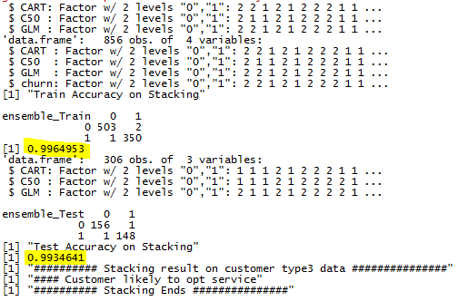
Model Building – Stacking Ensemble

Slide 43
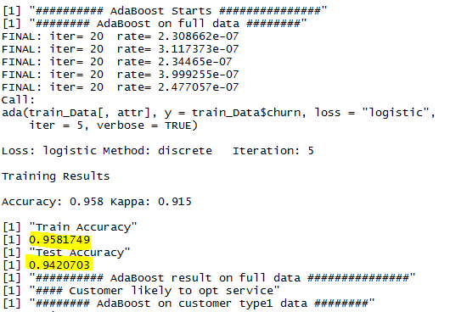
Model Building – Ada Boost

Slide 44
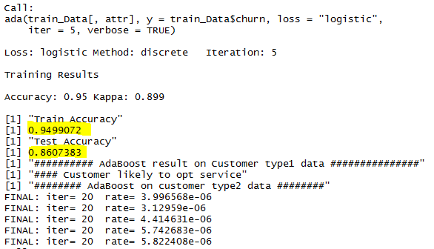
Model Building – Ada Boost

Slide 45
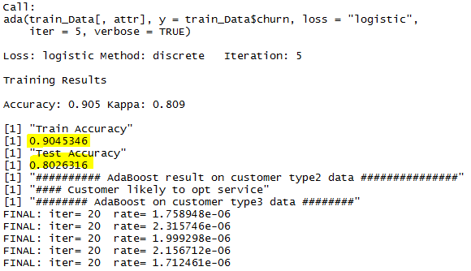
Model Building – Ada Boost

Slide 46
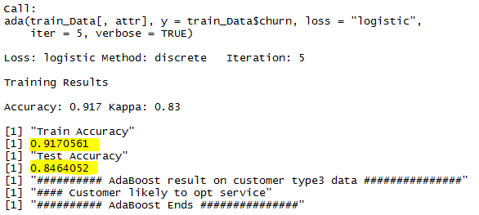
Model Building – Ada Boost

Slide 47
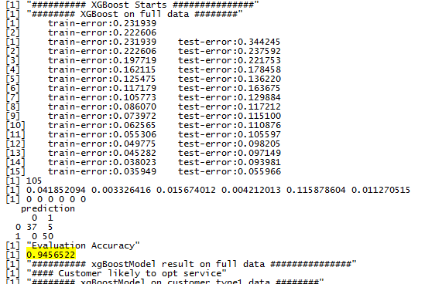
Model Building – XG Boost

Slide 48
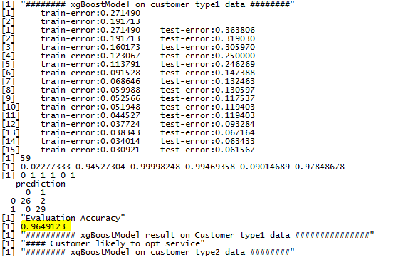
Model Building – XG Boost

Slide 49
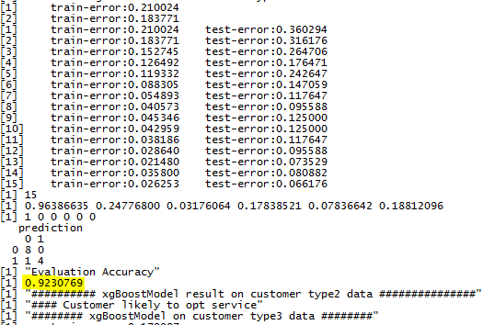
Model Building – XG Boost

Slide 50
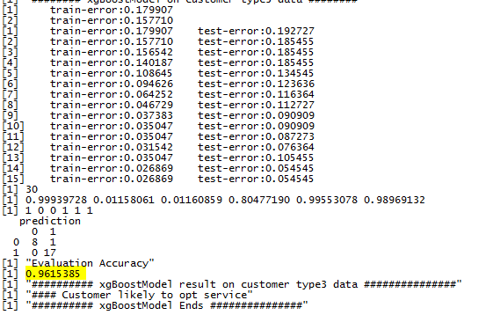
Model Building – XG Boost

Slide 51
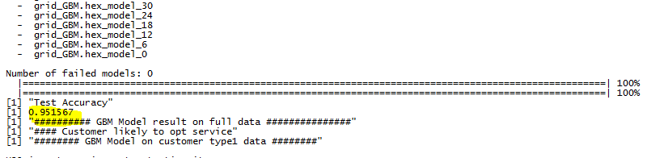
Model Building – GBM

Slide 52

Model Building – GBM

Slide 53

Model Building – GBM

Slide 54

Model Building – GBM

Slide 55

Research

Slide 56

Research

Slide 57

Research

Slide 58

Research

Slide 59

Research

Slide 60

Research

Slide 61

Research

Slide 62

Research

Slide 63

Research

Slide 64


Top States
Revenue wise
Least Churn
New York - $211,241
Florida - $153,668
Ohio - $ 149,789
Washington – 30%
Indiana – 35%
Connecticut – 36%

Slide 65


Worst Performing States
Revenue wise
More Churn
Wisconsin- $ 4914
Dist. of Columbia- $ 9088
Delaware- $ 10634
Nevada – 53%
Massachusetts – 52%
Missouri– 51%

Slide 66


City Statistics
Best City
Worst City
Rocky River - $ 4473
Bayonne - $ 4043
Rolling Meadows - $ 3693
Solon – 77%
Woodmere – 75%
Edina – 75%

Slide 67

Research – Loyal Customers

Slide 68

Research Un-loyal Customers

Slide 69

Forecasting the Churn and Revenue

Slide 70
Summary
2nd Visit is most churn
Sunday is best responsive
2nd and 3rd quarter should be aggressive
Customer type 1 is significant on past pricing
Customer type 3 is significant on past delays
Loyal customer should give more promotion
Least loyal customer should give more discounts

Slide 71
Things Acquired
Learnt to think about data
Learnt to do feature engineering
Learnt to approach classification model
Learnt to code in R
Learnt Tableau
Back Pain

